Slide 1

JNR
JNR Consulting, LLC
Audrey Moore, Kenneth Robinson, Megan Summerford

Slide 2
Extended Enterprise
Extended Enterprise Narrative
Executive Summary
Overall Table
Overall WCA
Overall WCA Narrative
Overall Value Chain
Overall Value Chain Narrative
Executive Summary for Sell Phase
Table for Sell Phase
Sell WCA
Sell WCA Narrative
Sell Value Chain
Sell Value Chain Narrative
Client Survey
Client Contract
Executive Summary for Research Phase
Table for Research Phase
Research WCA
Research WCA Narrative
Research Value Chain
Research Value Chain Narrative
Web Specification List
Color Scheme Chart
Executive Summary for Produce Phase
4
5
6
7
8
9
10
11
12
13
14
15
16
17
18
19
20
21
22
23
24
25
26-27
28
29

Slide 3
Table for Produce Phase
Produce Subtask
Produce WCA
Produce WCA Narrative
Produce Value Chain
Produce Value Chain Narrative
Site Navigation Page
Screen Shots from Developer Tool
Executive Summary for Deliver Phase
Table for Deliver Phase
Deliver WCA
Deliver WCA Narrative
Deliver Value Chain
Deliver Value Chain Narrative
Executive Summary for Service Phase
Table for Service Phase
Service WCA
Service WCA Narrative
Service Value Chain
Service Value Chain Narrative
Service and Maintenance Contract
Repository
30
31
32
33
34
35
36
37-38
39
40
41
42
43
44
45
46
47
48
49
50
51

Slide 4
Extended Enterprise
JNR Consulting, LLC (Company)
Sell
Research
Produce
Deliver
Service
Client
Research
Sell
Produce
Deliver
Service
Website Visitor
Research
Produce
Sell
Deliver
Service

Slide 5
Extended Enterprise Narrative
JNR Consulting (Company) will Deliver a website to the client, Ms. Moore, with support provided by the Project Manager, Kenneth Robinson.
Client can sell the website to others to better herself.
Website Visitor will be able to visit the website and research information about Ms. Moore. This is essential for potential employers that recruiting for vacant positions.

Slide 6
Executive Summary
We recommend that clients use JNR Consulting, LLC as their overall website developer. By using JNR Consulting, LLC web development services, the clients webpage will be created in a timely manner. The methodology covers all aspects of the clients needs.
After effectively researching the clients overall needs we have discovered that JNR Consulting, LLC methodology of creating and maintaining the clients website. By creating a specifications and survey application we discover detailed needs for the client, which gives the client total control over the outcome of there webpage. This approach gets the client completely involved with there webpage, which results in an overall excellent outcome.
In this report the methodology of JNR Consulting, LLC used a specific table that help create the phases of the website development process. The table shows the steps taken to process and effective website.
_____________________ ____________________
JNR Project manager Client
____________________ _____________________
Date Date

Slide 7
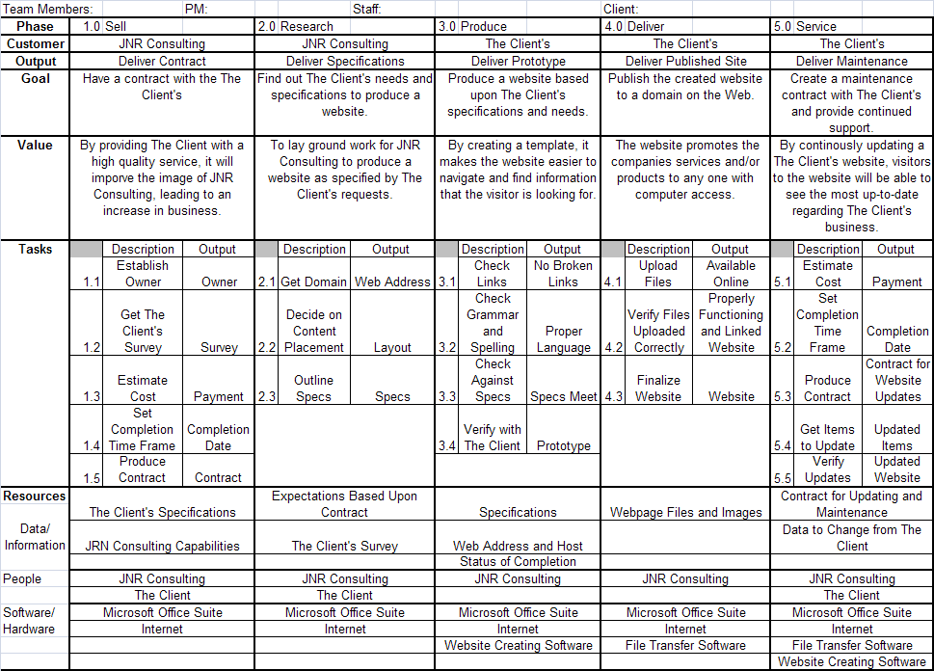
Overall
Table

Slide 8
Overall
WCA
Goal
Customer
Value
To design a website based on the clients criteria
JNR Consulting Client
the client has another method to promote their business on a global level
Product
Client’s Website
Work Practices
Sell - set up an agreement between JNR consulting and the client
Research- research the client’s specifications and need for their website
Produce- a website based in specs and needs
Deliver- publish it to a domain
Service- create a maintenance contact with the client
Technology
People
Data
Website
Web browsers
Visual webpage editor
Staff
Project manager
Client
Clients
specifications
Client surveys

Slide 9
Overall WCA Narrative
Goal- to design a website based on the clients criteria
Customer- Client
Product – website
Work Practices
Sell – set up an agreement between JNR consulting and the client
Research—research the client’s specifications and need for their website
Produce—a website based in specs and needs
Deliver—publish it to a domain
Service—Create a maintenance contact with the client
Data—clients specifications, client surveys
People – client, project manager, staff
Technology – web browsers, website, visual webpage editor (Frontpage)
Value—the client has another method to promote their business on a global level

Slide 10
Overall Value Chain
Sell
Agreement
Research
Client’s specifications
Produce
Website
Value Added
The client has another method to promote their business on a global level
Deliver
Publish
Service
Maintenance contact

Slide 11
Overall VC Narrative
Overall Goal:
To design a website based on the clients criteria
Sell – set up an agreement between JNR consulting and the client
Research—research the client’s specifications and need for their website
Produce—a website based in specs and needs
Deliver—publish it to a domain
Service—Create a maintenance contact with the client
Overall Value Added:
The client has another method to promote their business on a global level

Slide 12
Sell Executive Summary
We recommend that The Client contract with JNR Consulting, LLC because I will ensure the level of the quality of our work is the highest possible. We are committed to meeting the needs of customers for the most reasonable price.
Before finalizing a contract, Ms. Moore will know exactly what will be provided in her website. By using pre-defined work practices, this provides a foundation make sure that all areas of the website are covered.
The methodology used by JNR Consulting to execute the Sell phase creates a service contract using a variety of methods outlined in the table for Sell phase. The table outlines the steps such as defining goals and the value of these goals, the people, data, and technology it takes to make these goals happen, and the product and customer we will be working with. A value chain defines the value added by each step of our practices. JNR consulting personnel has concluded that this methodology is satisfactory at meeting and exceeding project goals.
______________________ ____________________
JNR Project Manager Client
________________________ ________________________
Date Date

Slide 13
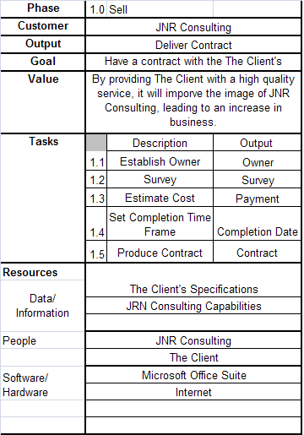
Table for Sell Phase

Slide 14
Sell WCA
Goal
Customer
Value
To set up an agreement contract between JNR consulting and the client
Project Team
By providing our clients with a high quality service it will improve the image of JNR consulting, leading to an increase in business.
Product
Contract
Work Practices
Research- establish what are the clients wants and needs for their website and what do they hope to get out of having a website
Produce- create a proposal contract, time frame, and budget for the client
Sell- the proposals to the client
Service- Negotiate the contact with the client
Deliver- the final, signed contract to the client
Technology
People
Data
Microsoft office
suite
Internet
JNR
Consulting
Client
Client
specifications

Slide 15
Sell WCA Narrative
Goal- To set up an agreement contract between JNR consulting and the client
Customer- project Team
Product- Contract
Work Practices
Research- establish what are the clients wants and needs for their website and what do they hope to get out of having a website
Produce- create a proposal contract, time frame, and budget for the client
Sell- the proposals to the client
Service- Negotiate the contact with the client
Deliver- the final, signed contract to the client
Technology- Microsoft Office Suite, internet
People-JNR Consulting, client
Data- Client specifications
Value- By providing our clients with a high quality service it will improve the image of JNR consulting, leading to an increase in business.

Slide 16
Sell Value Chain
Research
Needs for website
Produce
Proposal contract
Sell
Value Added
Proposal
By providing our clients with a high quality service it will improve the image of JNR consulting, leading to an increase in business.
Service
Negotiate
contact
Deliver
Final, signed contract

Slide 17
Sell VC Narrative
Overall Goal:
To set up an agreement contract between JNR consulting and the client
Research- establish what are the clients wants and needs for their website and what do they hope to get out of having a website
Produce- create a proposal contract, time frame, and budget for the client
Sell- the proposals to the client
Service- Negotiate the contact with the client
Deliver- the final, signed contract to the client
Overall Value Added:
By providing our clients with a high quality service it will improve the image of JNR consulting, leading to an increase in business.

Slide 18
Client
Survey
What is the desired time from do this project?
_____________________________________________________
What is your overall goal of your website?
_______________________________________________________
_______________________________________________________
What do you hope to gain with this website?
______________________________________________________________________________________________________________
What are some things you would like to see on your website?
______________________________________________________________________________________________________________
How many pages do you expect your webpage to include?
_____________________________________________________
Who will be browsing/using your website?
_____________________________________________________
What do you want hope your intended viewers will gain from your website?
_______________________________________________________
_______________________________________________________
Additional comments/preferences?
______________________________________________________________________________________________________________

Slide 19
Client Contract
123 Main St. SW
Tuscaloosa, Al 35487
_________________(client) has hired JNR Consulting to construct a website that will be fully operational by _______________(date). For every day late, JNR Consulting will suffer a $200 penalty.__________________(client) agrees to pay JNR Consulting $_________ for the construction of their website. A $_______ deposit will be required upfront to start the project and the remaining portion will be required upon completion. The client has until ______________(date) to cancel the contract, however the deposit will be non-refundable. If canceled later than ______________(cancellation date) the client is legally responsible for the full amount of the project.
JNR Consulting will not be liable for any material given to them by the client, to be put on the website, which infringes any copyright or trademark agreements. When website is complete all web code will be the property of the client, unless they buy a maintenance and service plan, in which case the code will be transferred to the client at the end of the maintenance and service contract.
___________________________________ ____________________________________
JNR Consulting Project Manager Signature Client Signature
_____________________________ ________________________________
Date Date

Slide 20
Executive Summary for Research Phase
We recommend that the website production proceed on to the Produce phase, continuing the process of creating and publishing the client’s website. . The methodology developed by JNR Consulting to execute the Delivery phase covers every aspect of the Produce phase process in a quick, efficient and effective manner.
Using this methodology, JNR Consulting is able to establish website specifications for the project. A discussion of the clients desires determine the client’s expectations. These expectations are modified to reflect what would be possible for the project team to accomplish with the resources they are given. These modifications are discussed with the client to ensure compliance with the client’s desires.
The methodology used by JNR Consulting to execute the Research phase creates website specifications using a variety of methods outlined in the table for Research phase. The table outlines the steps such as defining goals and the value of these goals, the people, data, and technology it takes to make these goals happen, and the product and customer we will be working with. A value chain defines the value added by each step of our practices. JNR consulting personnel has concluded that this methodology is satisfactory at meeting and exceeding project goals.
_____________________ _______________________
JNR Project Manager Client
_______________________________ ____________________________________
Date Date

Slide 21
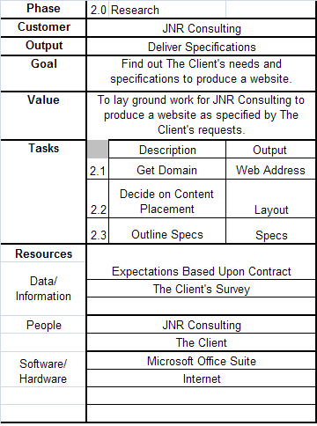
Table for Research Phase

Slide 22
Research
WCA
Goal
Customer
Value
to Research the client’s specifications and need for their website and relay them to the project team
Project Team
To lay ground work for JNR consulting to produce a website specified by the client’s request
Product
The clients specifications for their website
Work Practices
Research- the client’s goals, expectations, and requirements for their web site
Sell- ideas to the clients that are in line with their goals and expectations
Service- Revise ideas and goals with what the project team is capable of doing
Produce- the final revised specifications, goals and ideas for the website
Deliver- the final specifications to the project team and web designer
Technology
People
Data
Microsoft Office
Suite
Internet
JNR Consulting
Client
Expectations
based upon
contract
Client Survey

Slide 23
Research WCA Narrative
Goal- to Research the client’s specifications and need for their website and relay them to the project team
Customer- Project team
Product – the clients specifications for their website
Work Practices
Research- the client’s goals, expectations, and requirements for their web site
Sell- ideas to the clients that are in line with their goals and expectations
Service- Revise ideas and goals with what the project team is capable of doing
Produce- the final revised specifications, goals and ideas for the website
Deliver- the final specifications to the project team and web designer
Technology- Microsoft Office Suite, internet
People-JNR Consulting, client
Data- Expectations based upon contract, Client Survey
Value-To lay ground work for JNR consulting to produce a website specified by the client’s request

Slide 24
Research Value Chain
Research
Client’s goals, expectations, and requirements
Sell
Ideas
Service
Revise ideas
Value added
To lay ground work for JNR consulting to produce a website specified by the client’s request
Produce
Final revised specifications
Deliver
The final specifications to the project team

Slide 25
Research VC Narrative
Overall Goal:
To Research the client’s specifications and need for their website and relay them to the project team
Research- the client’s goals, expectations, and requirements for their web site
Sell- ideas to the clients that are in line with their goals and expectations
Service- Revise ideas and goals with what the project team is capable of doing
Produce- the final revised specifications, goals and ideas for the website
Deliver- the final specifications to the project team and web designer
Overall Value Added:
To lay ground work for JNR consulting to produce a website specified by the client’s request

Slide 26
Website Specifications List
Buyers Comments:_________________________________________________________
Buyers Comments:_________________________________________________________
Buyers Comments:_________________________________________________________
Or Create your own layout

Slide 27
Font: Georgia Times New Roman Arial Black
Number of Pages desired:___________
Background Color: Insert a least three color codes on the lines below ( See Chart on following page)
_________________ ________________ ________________
Web site Specifications List :
Buyer’s Comments:
_______________________________________________________________________________________________________________________________________________________________________________________________________________

Slide 28
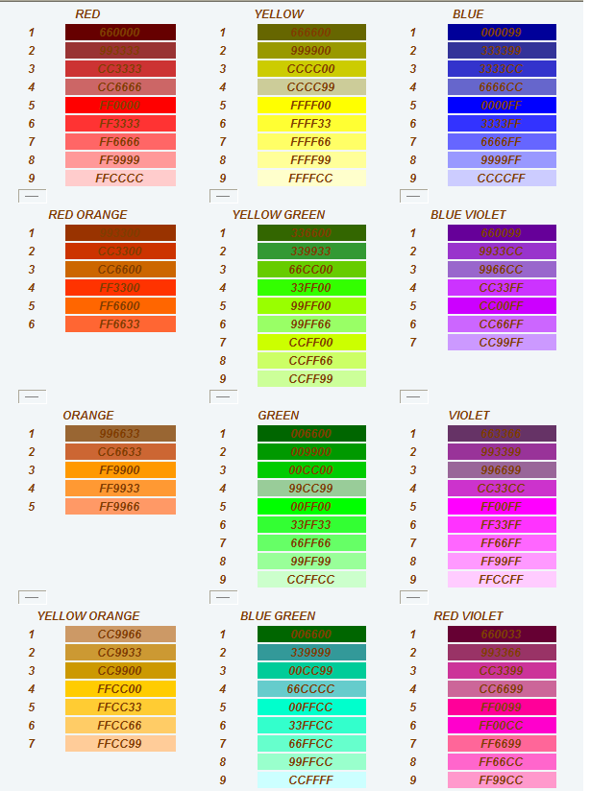
color Schemes

Slide 29
Executive Summary for Produce Phase
We recommend that the website production proceed on to the Deliver phase, continuing the process creating and publishing the client’s website. The methodology developed by JNR Consulting to execute the Delivery phase covers every aspect of the delivery phase process in a quick, efficient and effective manner.
Using this methodology, JNR Consulting is able to create a website prototype that contains the specifications produced by the Research phase. A basic site design was constructed based on these specifications. This prototype was viewed and revised by the client to reflect improvements by the client and the JNR Consulting project team. These revisions were included to deliver a final website prototype, and prototype was confirmed to ensure compliance with original website specifications.
The methodology used by JNR Consulting to execute the Produce phase creates a prototype website using a variety of methods outlined in the table for Produce phase. The table outlines the steps such as defining goals and the value of these goals, the people, data, and technology it takes to make these goals happen, and the product and customer we will be working with. A value chain defines the value added by each step of our practices. JNR consulting personnel has concluded that this methodology is satisfactory at meeting and exceeding project goals.
_____________________ _______________________
JNR Project Manager Client
____________________________ ______________________________
Date Date

Slide 30
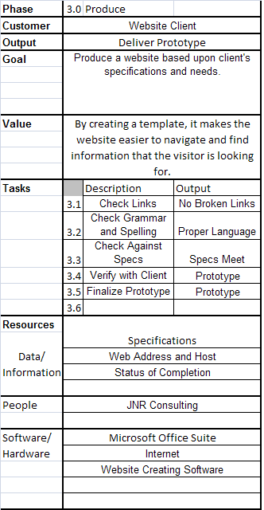
Table for Produce Phase

Slide 31
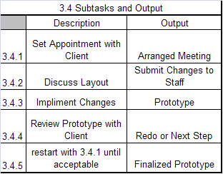
Produce Subtask

Slide 32
Produce
WCA
Goal
Customer
Value
Produce a website based on the clients specifications
Website Client
By creating a template it makes the website easier to navigate and find information the visitor was looking for
Product
Website template
Work Practices
Research- What is the most appropriate web development software application to use for the clients website
Produce- a template of the website based on all the research
Sell- the template to the client for approval
Service- the template based on the client’s feedback, likes and dislikes about the model
Deliver- the final template website to the client for acceptance
Technology
People
Data
Microsoft Office
Suite
Internet
Web creating
software
Specifications
web address
and host
Status
completion
JNR Consulting

Slide 33
Produce WCA Narrative
Goal- Produce a website based on the clients specifications and needs
Customer- Website Client
Product- Website Template
Work Practices-
Research- What is the most appropriate web development software application to use for the clients website
Produce- a template of the website based on all the research
Sell- the template website to the client for approval
Service- the template based on the client’s feedback, likes and dislikes about the model
Deliver- the final website to the client for acceptance
Technology- Microsoft Office Suite, internet, Web creating software
People-JNR Consulting
Data- Specifications, web address and host, status completion
Value- By creating a template it makes the website easier to navigate and find information the visitor was looking for

Slide 34
Produce Value Chain
Research
Appropriate web development software
Produce
Template of website
Sell
Template website to client
Value Added
By creating a template it makes the website easier to navigate and find information the visitor was looking for
Service
Template based on the client’s feedback
Deliver
Final website to the client

Slide 35
Produce VC Narrative
Overall Goal:
Produce a website based on the clients specifications
Research- What is the most appropriate web development software application to use for the clients website
Produce- a template of the website based on all the research
Sell- the template website to the client for approval
Service- the template based on the client’s feedback, likes and dislikes about the model
Deliver- the final website to the client for acceptance
Overall Value:
By creating a template it makes the website easier to navigate and find information the visitor was looking for

Slide 36
Site Navigation
Index.html
about.html
photos.html
resume.doc
Email

Slide 37
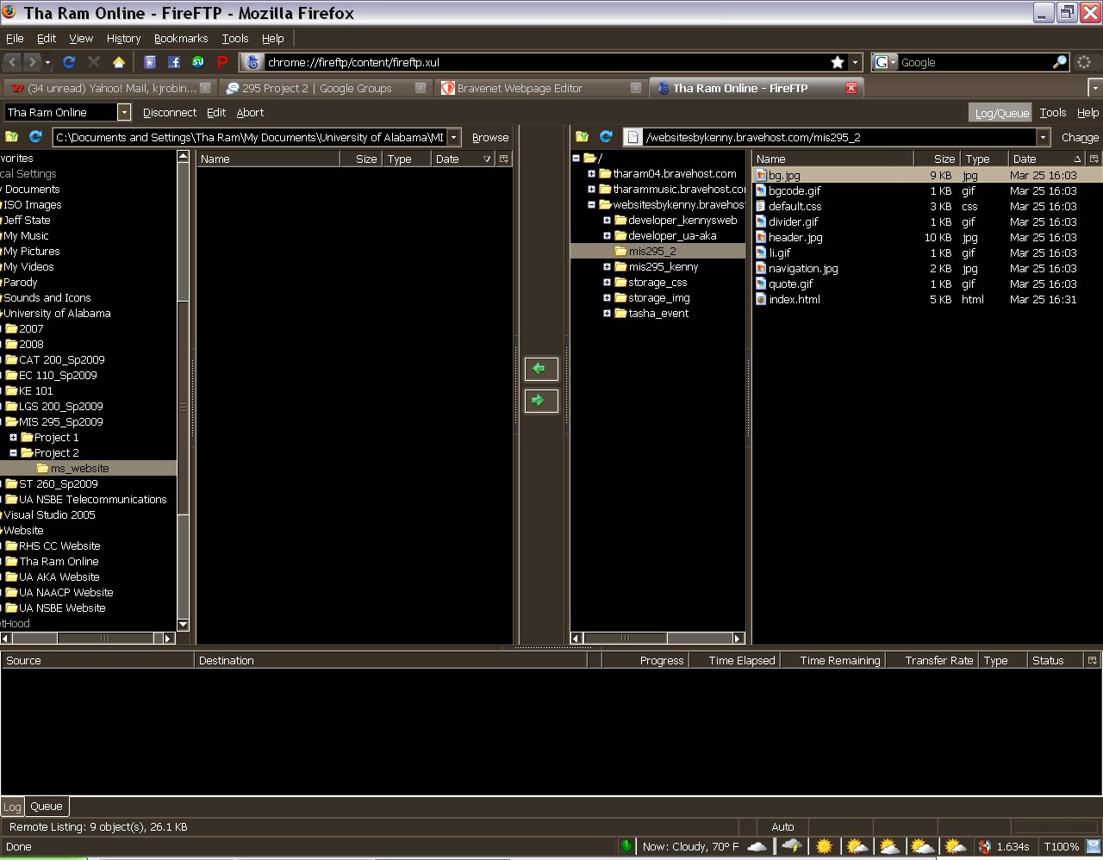

Slide 38
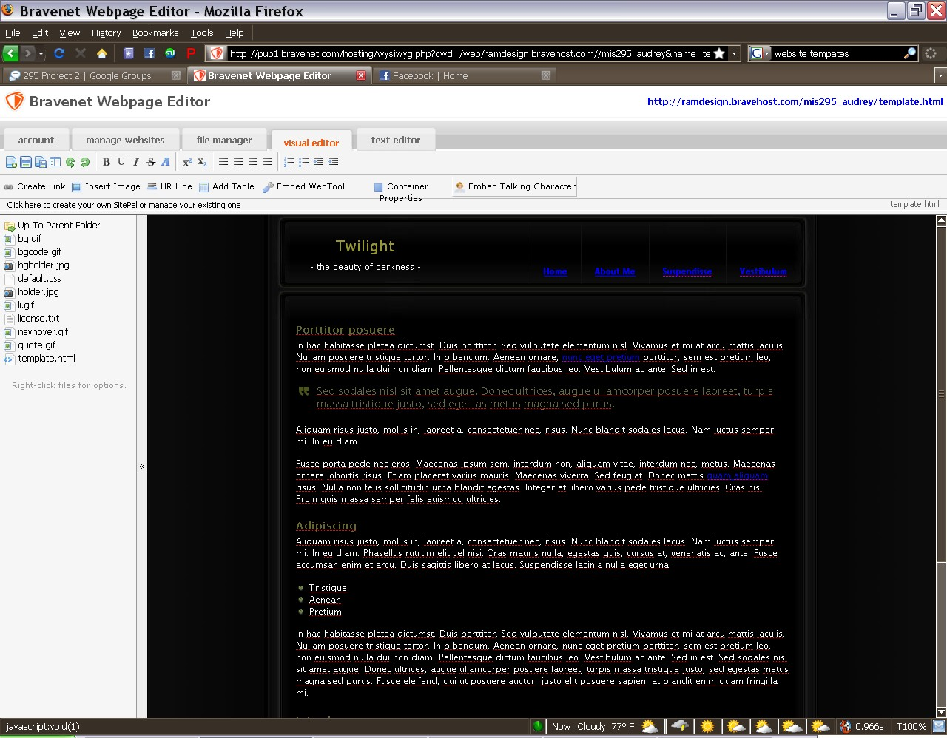

Slide 39
Executive Summary for Delivery Phase
We recommend that the website production proceed on to the service phase, continuing the process of creating and publishing the client’s website. The methodology developed by JNR Consulting to execute the Delivery phase covers every aspect of the delivery phase process in a quick, efficient and effective manner.
Using this methodology, JNR Consulting was able to insert the completed website into the internet and make it accessible to anyone with an internet connection. Research of the domain hosting solutions brings in the correct domain solution to be used by the website. The information is presented to the client for approval. Based on the choice of domain, the website is then formatted to comply with the specifications of the chosen domain, and this finalized website is published and validated to ensure compliance with the domain requirements and client’s desires.
The methodology used by JNR Consulting to execute the Delivery phase creates a completed website fully hosted on the website using a variety of methods outlines in the table and WCA for the delivery phase. The table outlines the steps such as defining goals and the value of these goals, the people, data, and technology it takes to make these goals happen, and the product and customer we will be working with. A value chain defines the value added by each step of our practices. JNR consulting personnel has concluded that this methodology is satisfactory at meeting and exceeding project goals.
_____________________ ______________________
JNR Project Manager Client
____________________________ ______________________________
Date Date

Slide 40
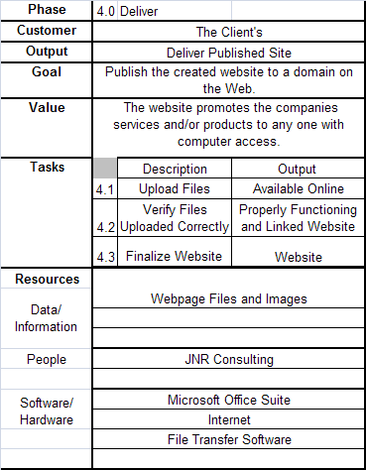
Table for Deliver Phase

Slide 41
Deliver
WCA
Goal
Customer
Value
Publish the created website to a domain on the web
Website Client
The website promotes the companies services and/or products to any one with computer access
Product
Published Website
Work Practices
Research- the cost and benefit of each domain, which is better for the client, and how to publish to that domain
Sell- your domain research to the client
Produce- with the input of the client and our research choose the best fitting domain for the client’s website
Service- make corrections to coding to load to chosen domain
Deliver- the published website
Technology
People
Data
Microsoft Office
Suite
Internet
File transfer
software
JNR Consulting
Webpage files
and Images

Slide 42
Deliver WCA Narrative
Goal- Publish the created website to a domain on the web
Customer- Client
Product-Published Website
Work Practices-
Research- the cost and benefit of each domain, which is better for the client, and how to publish to that domain
Sell- your domain research to the client
Produce- with the input of the client and our research choose the best fitting domain for the client’s website
Service- make corrections to coding to load to chosen domain
Deliver- the published website
Technology- Microsoft Office Suite, Internet, File transfer software
People-JNR Consulting
Data- Webpage files and Images
Value-the website promotes the companies services and/or products to any one with computer access

Slide 43
Deliver
Value Chain
Research
Cost and benefit of each domain
Sell
Domain research
Produce
Best fitting domain
Value Added
The website promotes the companies services and/or products to any one with computer access
Service
Corrections to coding
Deliver
Published website

Slide 44
Deliver VC Narrative
Overall Goal:
Publish the created website to a domain on the web
Research- the cost and benefit of each domain, which is better for the client, and how to publish to that domain
Sell- your domain research to the client
Produce- with the input of the client and our research choose the best fitting domain for the client’s website
Service- make corrections to coding to load to chosen domain
Deliver- the published website
Overall Value Added-
The website promotes the companies services and/or products to any one with computer access

Slide 45
Executive Summary for Service Phase
We recommend that the website construction project be considered complete. The methodology developed by JNR Consulting to execute the Service phase covers every aspect of the Service phase process in a quick, efficient and effective manner.
Using this methodology, JNR Consulting is able to establish the foundation of a service contract. Through much research we are able to determine the expected cost of providing maintenance for the client’s website. The information found in our research is used to construct our Service and Maintenance contract. This contract is verified and signed by the client as well as the project manager.
The methodology used by JNR Consulting to perform the Service Phase creates a service contract using a variety of methods outlined in the table and the WCA for the Service phase. The table outlines the steps such as defining goals and the value of these goals, the people, data, and technology it takes to make these goals happen, and the product and customer we will be working with. A value chain defines the value added by each step of our practices. JNR consulting personnel has concluded that this methodology is satisfactory at meeting and exceeding project goals.
______________________ _____________________
JNR Project Manager Client
_______________________________ ______________________________
Date Date

Slide 46
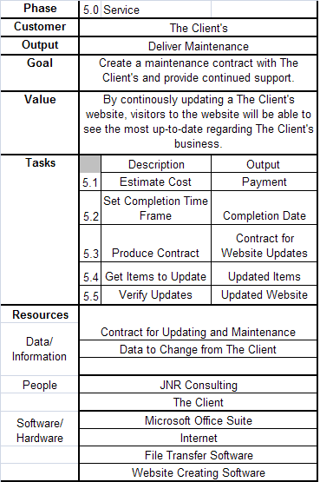
Table for Service Phase

Slide 47
Service
WCA
Goal
Value
Customer
To create a maintenance and service contract with the client and provide continued support
Client
by continuously updating a client’s website visitors to the website will be able to see the most up-to-date regarding the client’s business
Product
Maintenance and service contract
Work Practices
Research- the normal cost of maintenance and service for a website
Produce- based on the research findings create a maintenance and service contract
Sell- the maintenance and service contract to the client
Deliver-receive a signed copy of the maintenance and service contract
Service- follow up on all maintenance and services needed
Technology
People
Data
Microsoft Office
Suite
Internet
File transfer software
Web creating
software
JNR Consulting
Client
Data to change
from client
Contact for update
and maintenance

Slide 48
Service WCA Narrative
Goal-To create a maintenance and service contract with the client and provide continued support
Customer-Client
Product- Maintenance and service contract
Work Practices-
Research- the normal cost of maintenance and service for a website
Produce- based on the research findings create a maintenance and service contract
Sell- the maintenance and service contract to the client
Deliver- receive a signed copy of the maintenance and service contract
Service- follow up on all maintenance and services needed
Technology- Microsoft Office Suite, Internet, File transfer software, Web creating software
People-JNR Consulting, Client
Data- Contact for update and maintenance, Data to change from client
Value-by continuously updating a client’s website visitors to the website will be able to see the most up-to-date regarding the client’s business

Slide 49
Service
Value Chain
Research
Cost of maintenance
Produce
Maintenance and service contract
Sell
Value Added
Maintenance and service contract
by continuously updating a client’s website visitors to the website will be able to see the most up-to-date regarding the client’s business
Deliver
Receive signed
contract
Service
Follow up on needs

Slide 50
Service VC Narrative
Overall Goal-
To create a maintenance and service contract with the client and provide continued support
Research- the normal cost of maintenance and service for a website
Produce- based on the research findings create a maintenance and service contract
Sell- the maintenance and service contract to the client
Deliver-receive a signed copy of the maintenance and service contract
Service- follow up on all maintenance and services needed
Overall Value Added-
By continuously updating a client’s website visitors to the website will be able to see the most up-to-date regarding the client’s business

Slide 51
Service and Maintenance Contract
123 Main St SW
Tuscaloosa, AL 35487
The terms of the contract are as follows:
The client has these options to a service and maintenance contract:
1 Year Service and Maintenance Contract $250
2 Year Service and Maintenance Contract $450
10 Year Service and Maintenance Contract $1,500
Lifetime Service and Maintenance Contract $3,000
No Service Contract
As the client I understand that if I choose not to sign a service and maintenance contract JNR Consulting is not held liable for any damages, changes, viruses, ect. on the website. I understand that the code to the website will be given to me at the completion of the project and I am responsible for any fees the website may incur.
All service contracts include minor changes to the website, 24 hour phone and e-mail technical support, cost associated with hosting the site, and weekly check-ups to the site to be sure everything is functioning properly.
Minor changes include but are not limited to changes to site graphic, text, and links. In the event of any major changes that you wish to make to the website, such as changes to site structure and major redesign of the site, there will be a fee that will be decided upon by the staff of JNR Consulting.
JNR Consulting reserves the right to make the final decision on what constitutes as a major or minor change to the site.
I have read the entire Service and Maintenance Contract and I understand and agree to the terms and conditions that are set forth in this contract:
_________________________ ___________________________
JNR Project Manager Client
__________________________ ______________________________
Date Date

Slide 52
Repository

Slide 53
Meeting Times
March 4, 2009 8:00-9:15 Houser Hall Lab
March 10, 2009 6:30-8:00 EI Lab
March 23, 2009 6:30-8:15 EI Lab
March 25,2009 6:30-8:30 EI Lab
March 30,2009 6:30-8:00 EI Lab
April 1, 2009 6:30-9:00 EI Lab
April 1, 2009 9:15-10:15 AIMS 111
Graders Meeting
April 2, 2009 9:15-

